Slide 1
Inverse Design

Slide 2
Forward Prediction
So far you have learned…
Featurization
Materials
Descriptors
Property
Machine learning
Build dataset, and train ML model
Suggest promising
materials
Materials generation
Materials space
Rapid Prediction via ML
Training set
Ideal Material

Slide 3
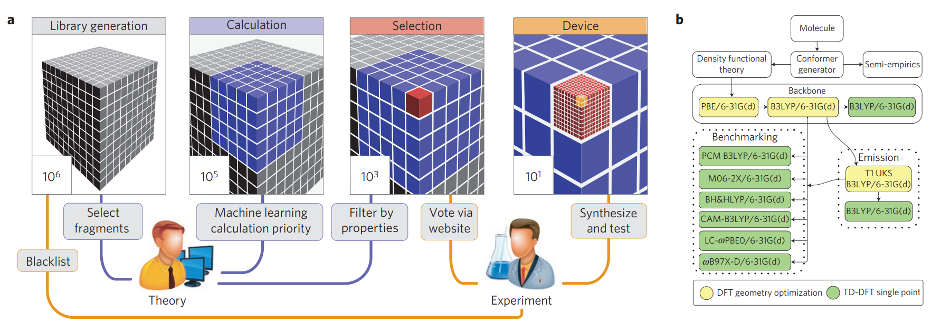
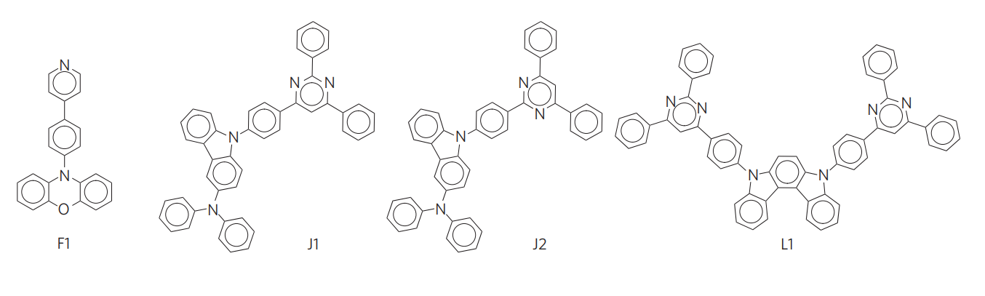
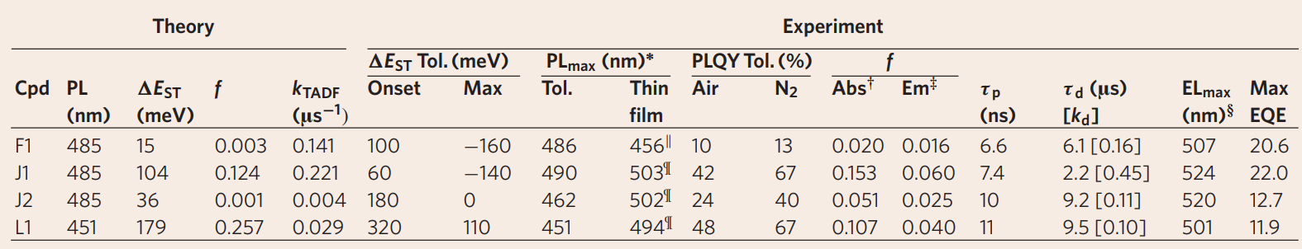
Design of efficient molecular organic light-emitting diodes by a high-throughput virtual screening and experimental approach
Nature Materials 2016, 15, 1120

Slide 4
Inverse Design
Forward Prediction
Featurization
Materials
Descriptors
Property
Machine learning
You can only search the materials within the scope you defined
Inverse Prediction
Property
Materials
Machine learning
Machine learning model directly outputs the materials of your interest

Slide 5
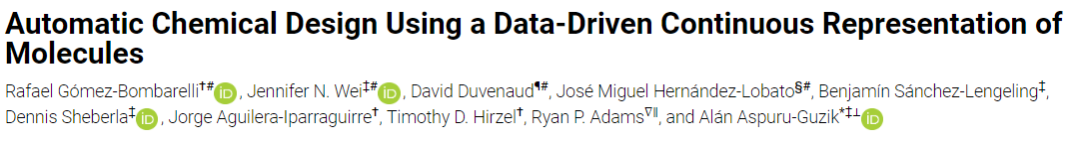
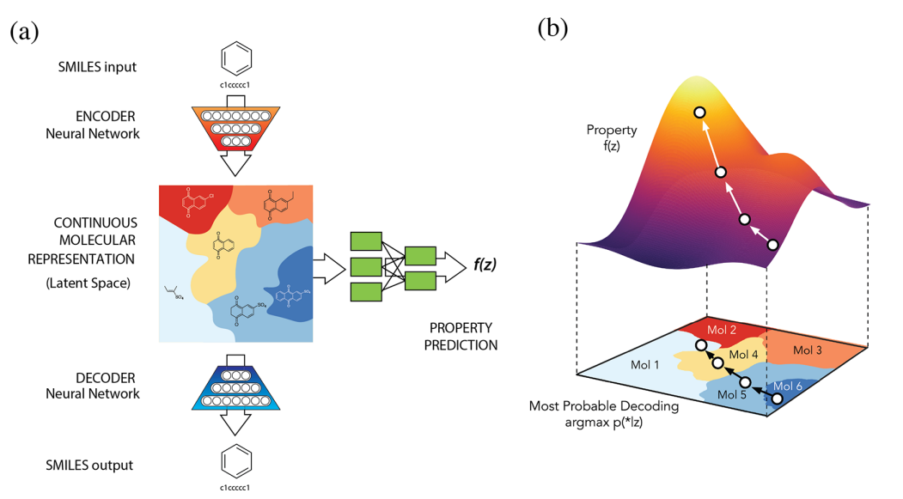
Variational Autoencoder
ACS Cent. Sci. 2018, 4, 2, 268–276

Slide 6
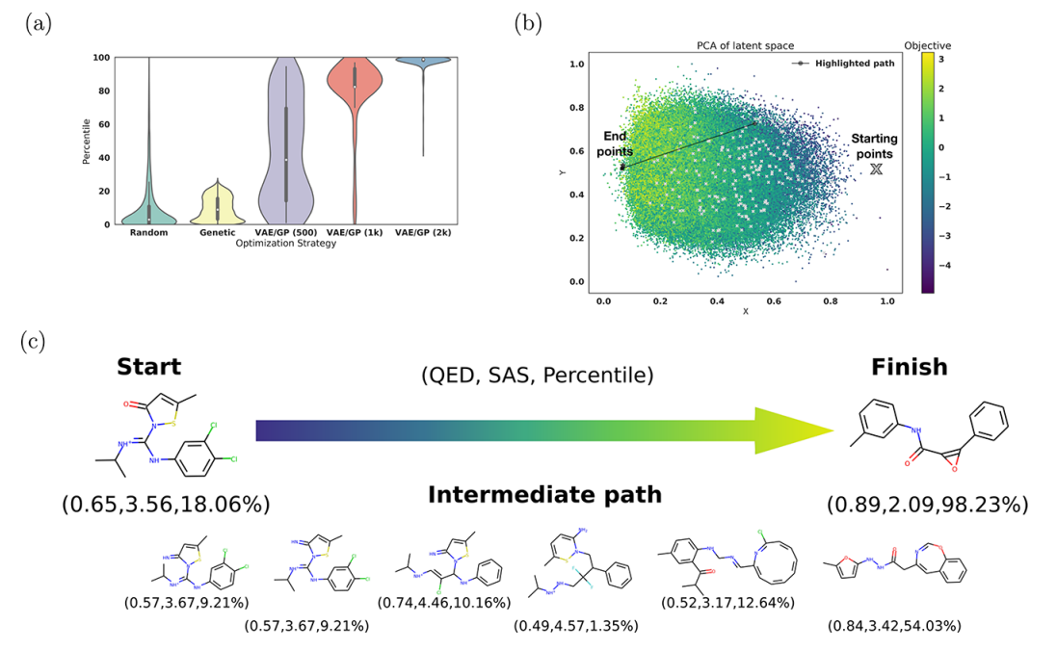
Variational Autoencoder

Slide 7
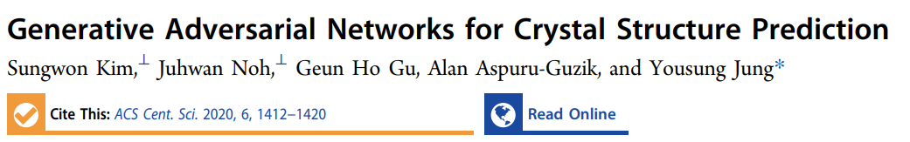
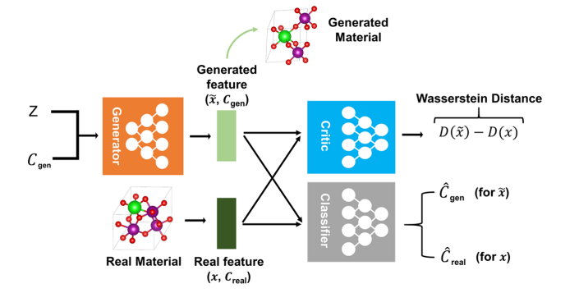
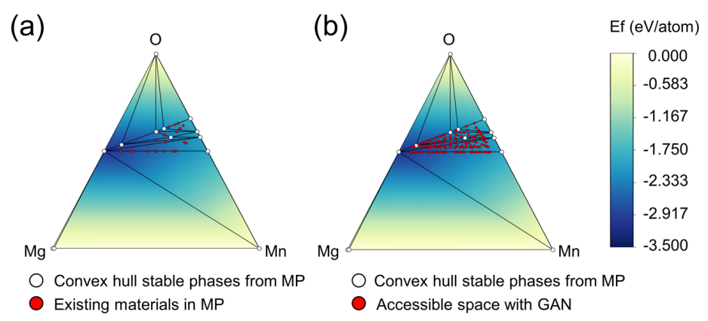
Generative Adversarial Network

Slide 8
Autoencoder

Slide 9
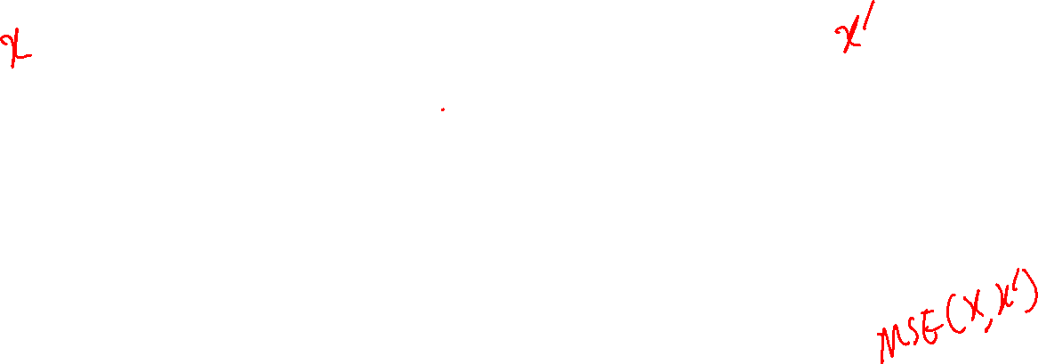
Autoencoder
Encoder
Decoder
Bottleneck
Latent dimension
300 neurons
300 neurons
500 neurons
500 neurons
1000 neurons
1000 neurons

Slide 10
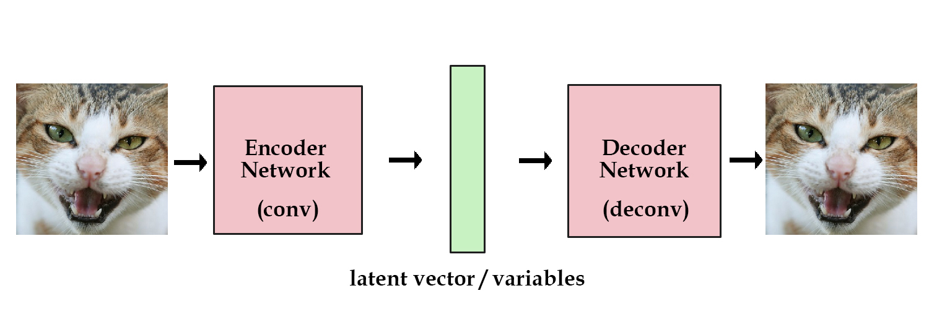
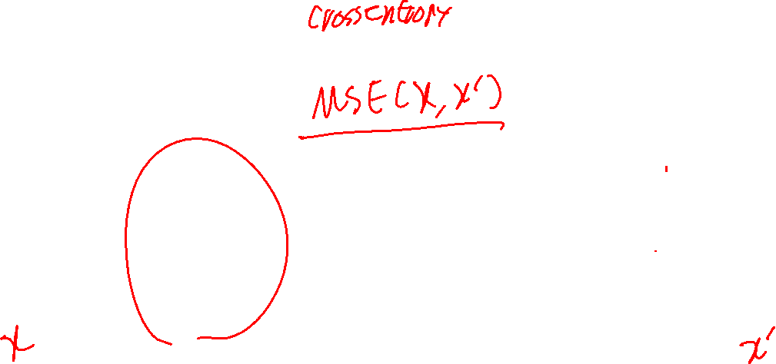
Autoencoder
Reconstruction Loss
https://kvfrans.com/variational-autoencoders-explained/

Slide 11
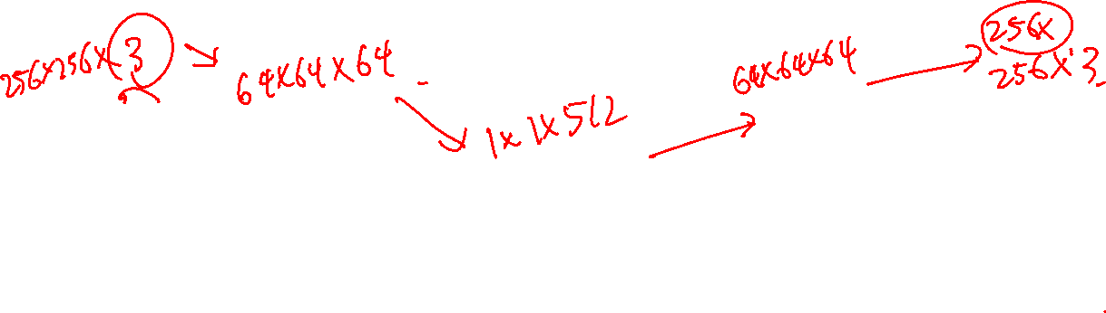
Image Encoder
Latent Space
CNN Encoder
CNN Decoder

Slide 12
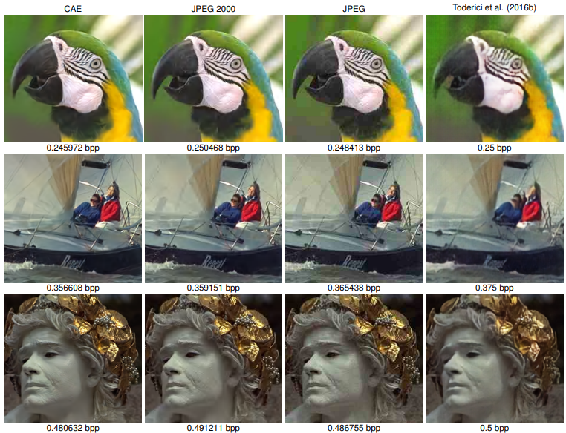
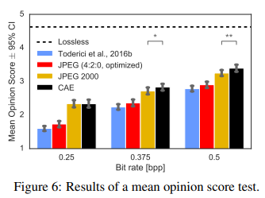
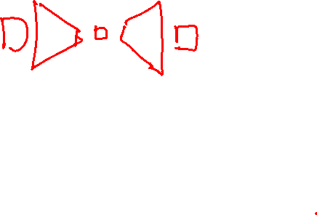
Autoencoder as a Data Compressor
https://openreview.net/forum?id=rJiNwv9gg

Slide 13
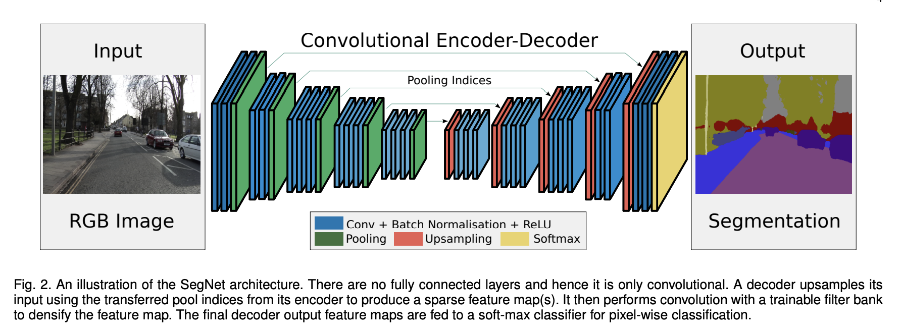
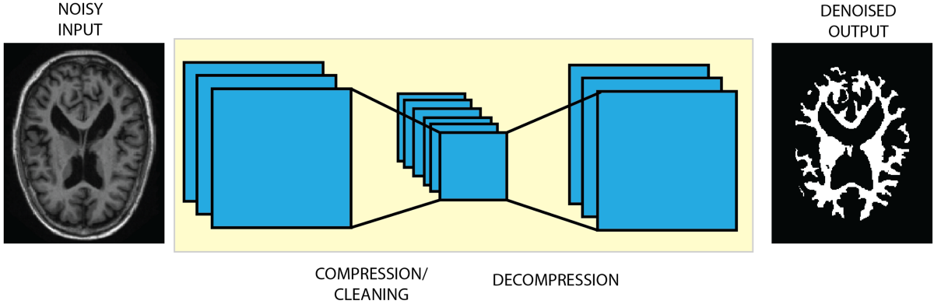
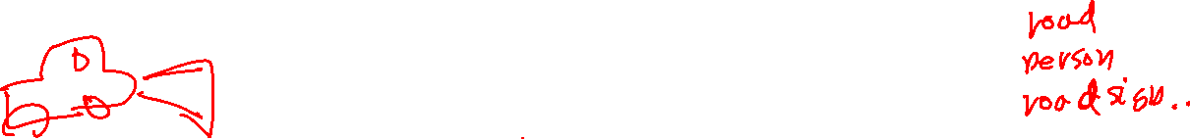
Segmentation
https://arxiv.org/abs/1511.00561; https://blog.insightdatascience.com/brain-mri-image-segmentation-using-stacked-denoising-autoencoders-4e91417688f6

Slide 14
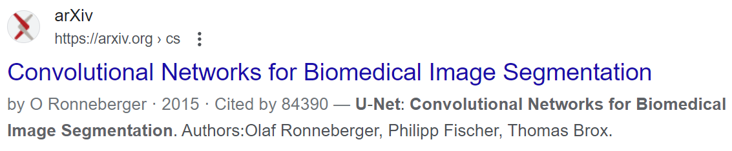
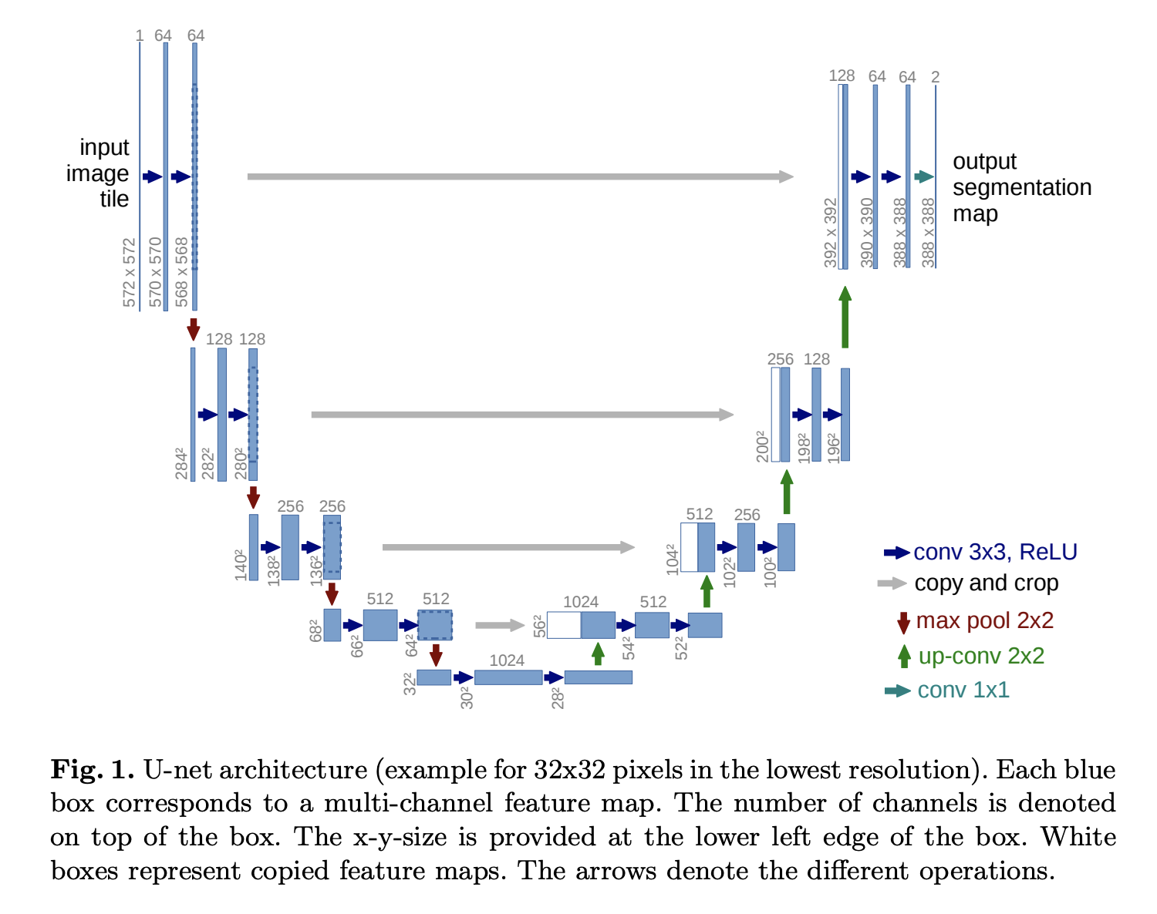
Segmentation

Slide 15
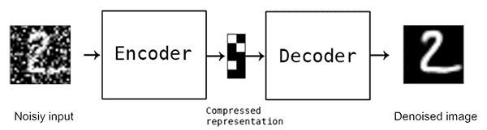
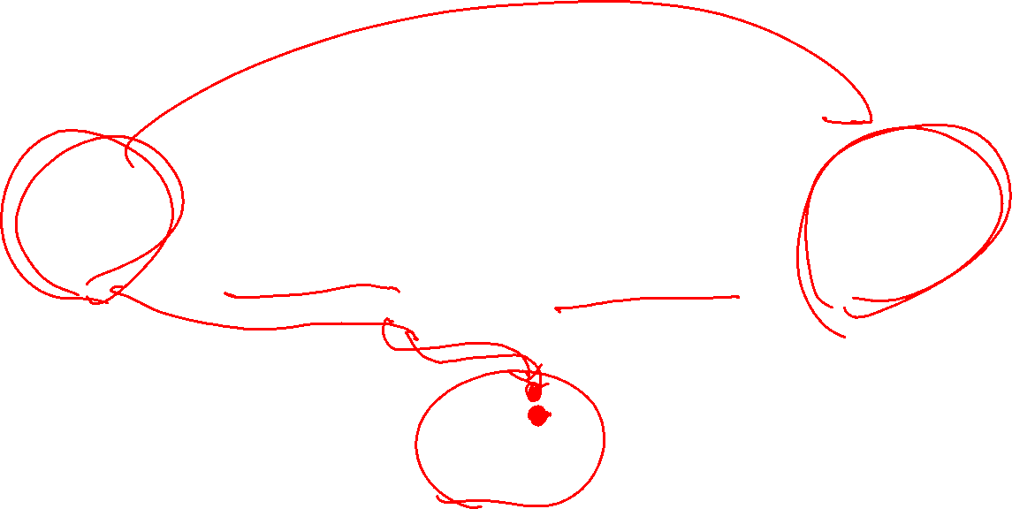
Denoising Encoder
https://blog.keras.io/building-autoencoders-in-keras.html

Slide 16
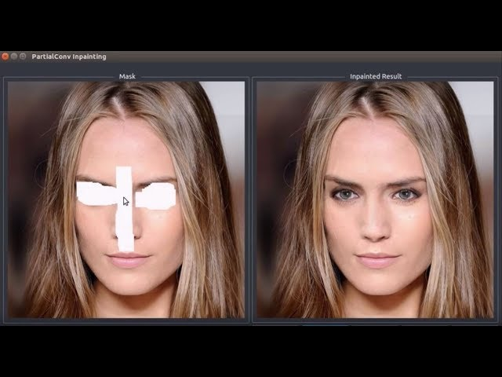
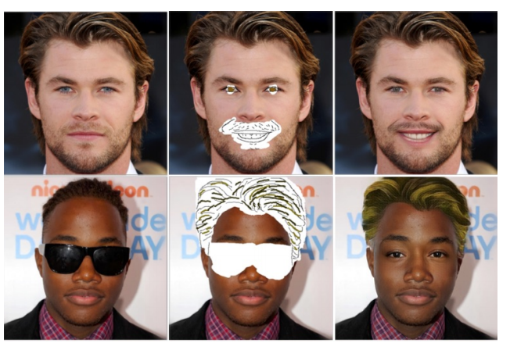
Neural Inpainting
https://blog.keras.io/building-autoencoders-in-keras.html

Slide 17
Coding
import torch.nn as nn
class Encoder(nn.Module):
def __init__(self):
super(Encoder, self, input_fea, hidden_fea).__init__()
self.act = nn.Softplus()
self.lin1 = nn.Linear(input_fea, hidden_fea)
self.lin2 = nn.Linear(hidden_fea, hidden_fea)
def forward(self, x):
x = self.lin1(x)
x = self.act(x)
x = self.lin2(x)
x = self.act(x)
return h
class AE(nn.Module):
def __init__(self, input_fea, hidden_fea, out_fea):
super(AE, self).__init__()
self.encoder = Encoder(input_fea, hidden_fea)
self.decoder = Decoder(hidden_fea, out_fea)
def forward(self, x):
h = self.encoder(x)
recon_x = self.decoder(h)
return recon_x, h
import torch.nn as nn
class Decoder(nn.Module):
def __init__(self):
super(Encoder, self, hidden_fea, out_fea).__init__()
self.act = nn.Softplus()
self.lin1 = nn.Linear(hidden_fea, hidden_fea)
self.lin2 = nn.Linear(hidden_fea, out_fea)
def forward(self, x):
x = self.lin1(x)
x = self.act(x)
x = self.lin2(x)
return x

Slide 18
Variational Autoencoder

Slide 19
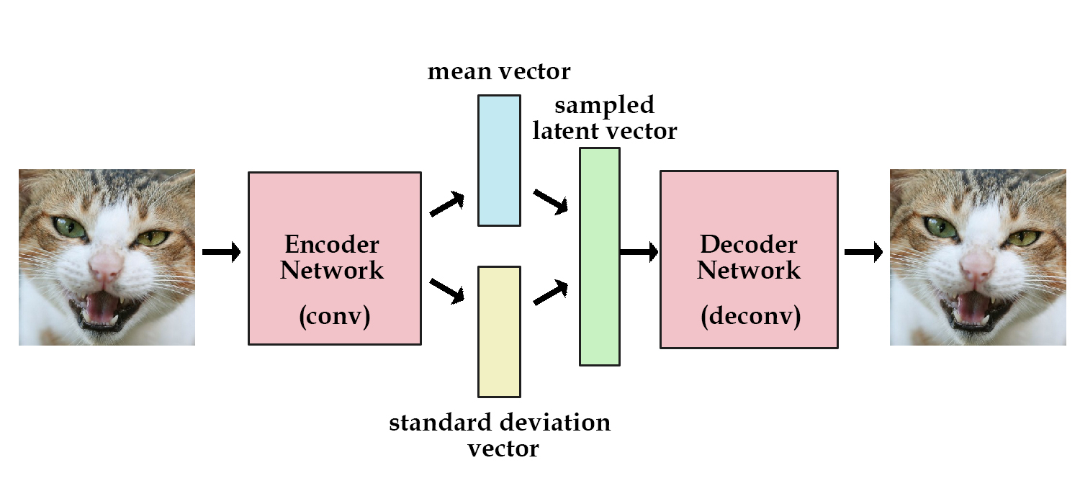
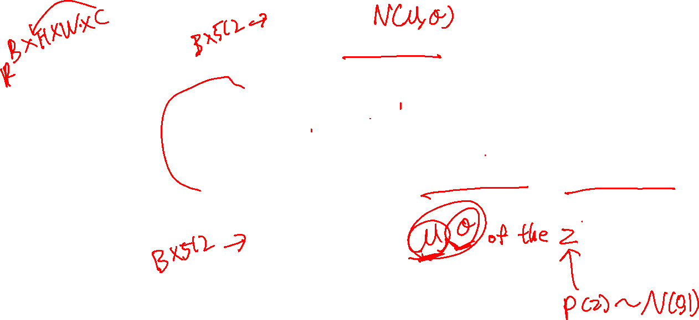
Variational Autoencoder
Encoder predicts two vectors per input: mean (μ), standard deviation (σ).
“Probability distribution of the input in the latent space”
https://kvfrans.com/variational-autoencoders-explained/

Slide 20
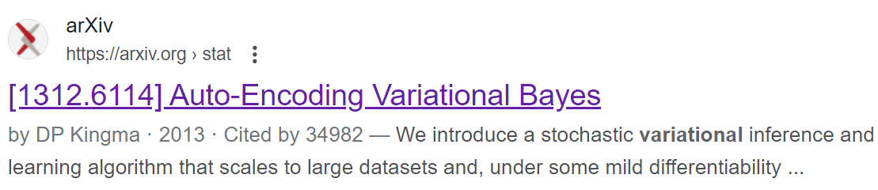
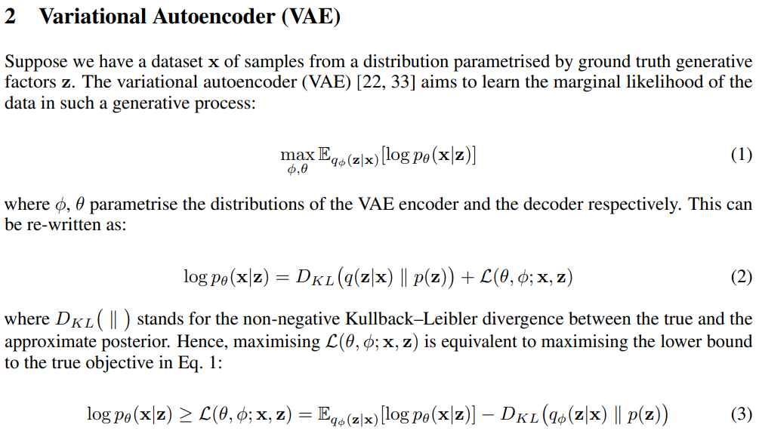
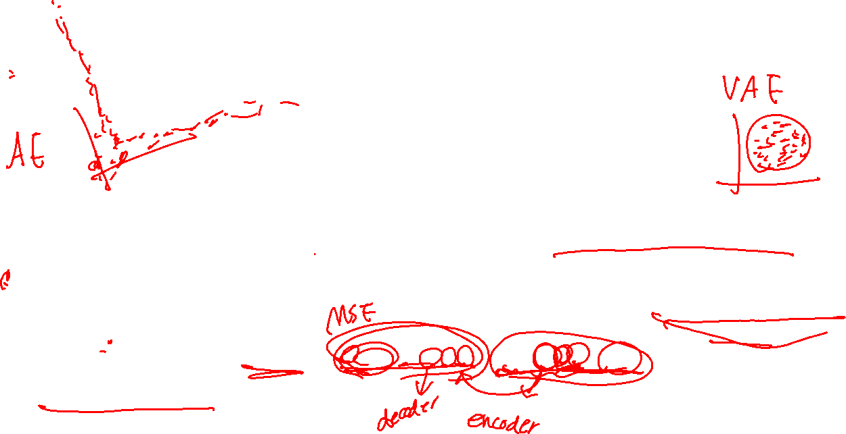
VAE Loss function
Kullback-Leibler divergence
Quantifies the difference between the two distribution
Assume the distribution is Gaussian
Reconstruction Loss
μ, σ stay as close to N(0,1)
https://arxiv.org/abs/1804.03599

Slide 21
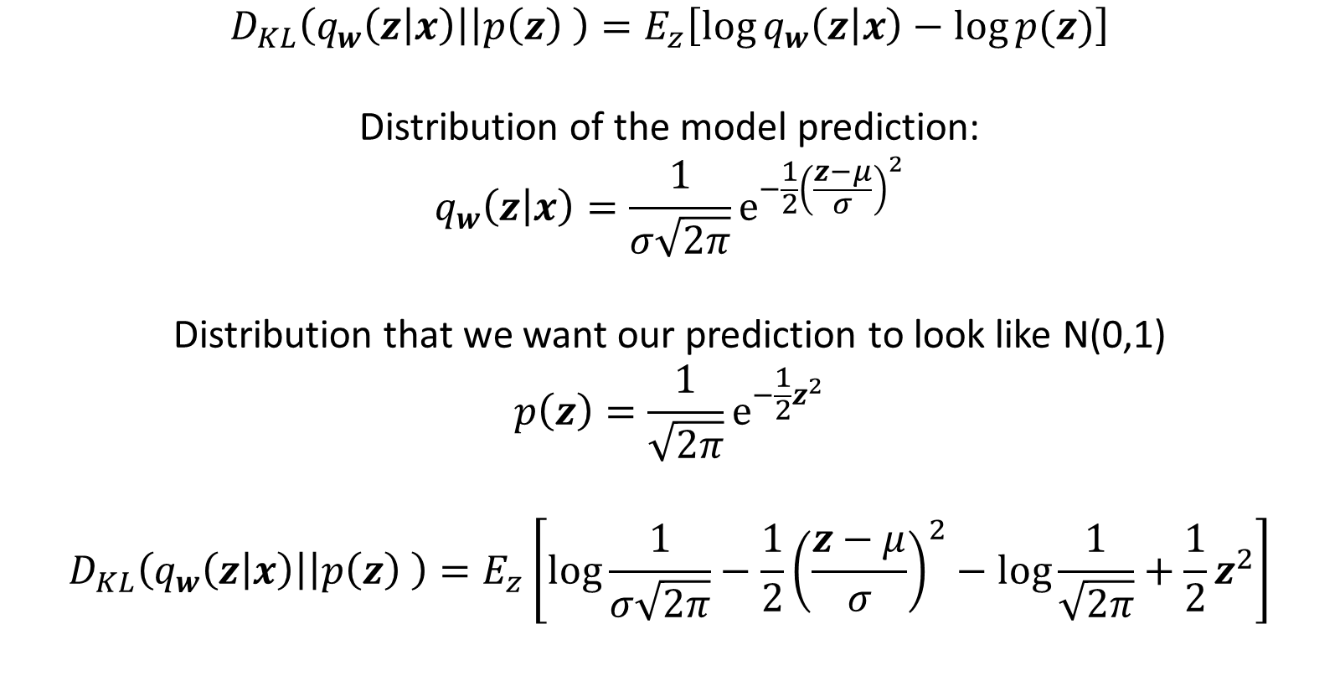
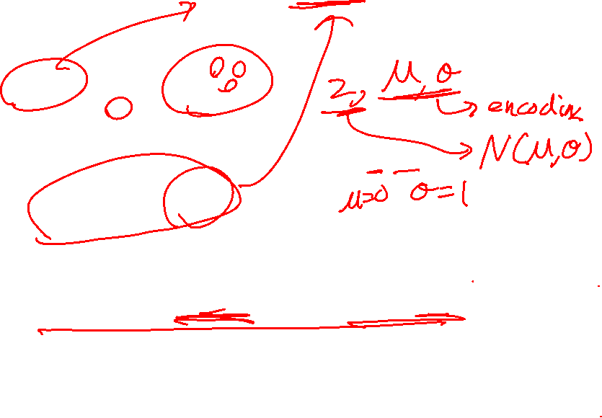
Variational Autoencoder Loss function
$$D_{KL}\left(q_{w}\left(z | x\right)\right|\left|p\left(z\right) \right)=E_{z}\left[\log{q_{w}\left(z | x\right)}−\log{p(z)}\right]$$
Distribution of the model prediction:
$$q_{w}\left(z | x\right)=\frac{1}{σ\sqrt{2π}}e^{−\frac{1}{2}{\left(\frac{z−μ}{σ}\right)}^{2}}$$
Distribution that we want our prediction to look like N(0,1)
$$p\left(z\right)=\frac{1}{\sqrt{2π}}e^{−\frac{1}{2}z^{2}}$$
$$D_{KL}\left(q_{w}\left(z | x\right)\right|\left|p\left(z\right) \right)=E_{z}\left[\log{\frac{1}{σ\sqrt{2π}}}−\frac{1}{2}{\left(\frac{z−μ}{σ}\right)}^{2}−\log{\frac{1}{\sqrt{2π}}}+\frac{1}{2}z^{2}\right]$$

Slide 22
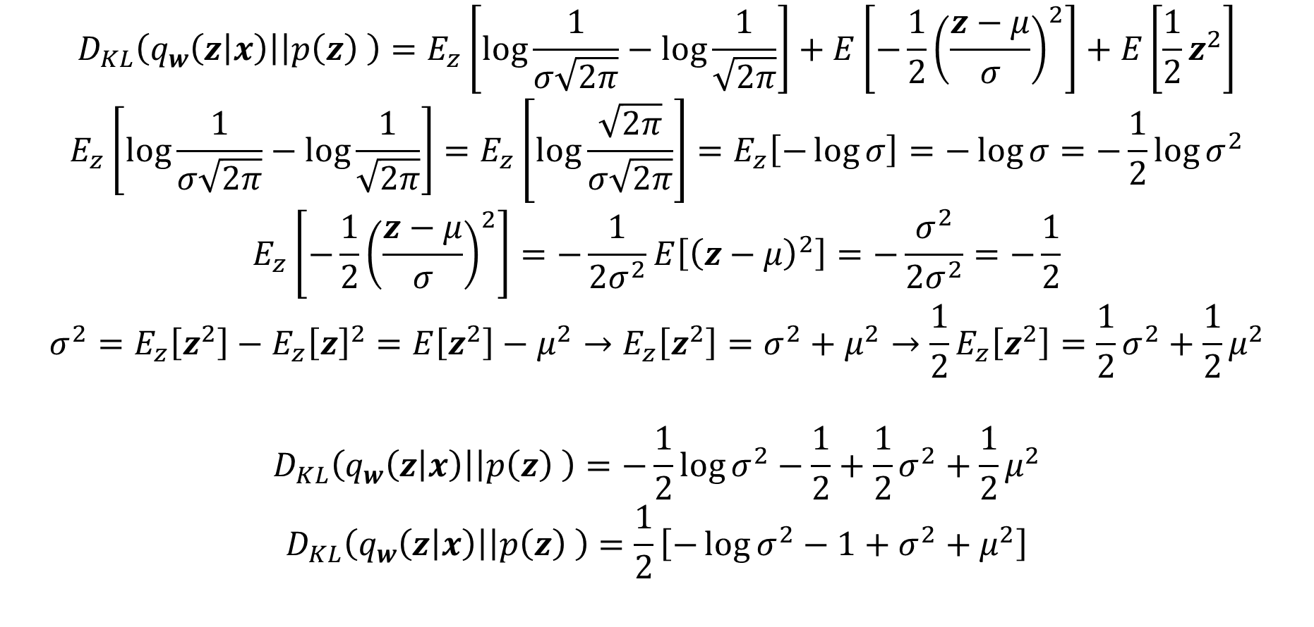
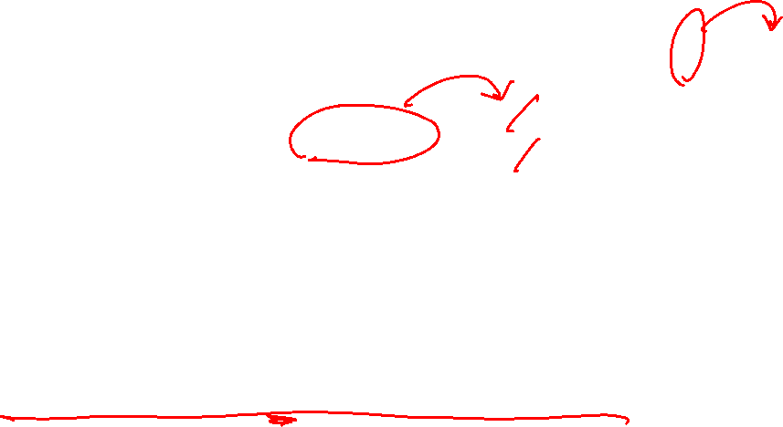
Variational Autoencoder Loss function
$$D_{KL}\left(q_{w}\left(z | x\right)\right|\left|p\left(z\right) \right)=E_{z}\left[\log{\frac{1}{σ\sqrt{2π}}}−\log{\frac{1}{\sqrt{2π}}}\right]+E\left[−\frac{1}{2}{\left(\frac{z−μ}{σ}\right)}^{2}\right]+E\left[\frac{1}{2}z^{2}\right]$$
$$E_{z}\left[\log{\frac{1}{σ\sqrt{2π}}}−\log{\frac{1}{\sqrt{2π}}}\right]=E_{z}\left[\log{\frac{\sqrt{2π}}{σ\sqrt{2π}}}\right]=E_{z}\left[−\log{σ}\right]=−\log{σ}=−\frac{1}{2}\log{σ^{2}}$$
$$E_{z}\left[−\frac{1}{2}{\left(\frac{z−μ}{σ}\right)}^{2}\right]=−\frac{1}{2σ^{2}}E\left[{\left(z−μ\right)}^{2}\right]=−\frac{σ^{2}}{2σ^{2}}=−\frac{1}{2}$$
$$σ^{2}=E_{z}\left[z^{2}\right]−E_{z}{\left[z\right]}^{2}=E\left[z^{2}\right]−μ^{2}→E_{z}\left[z^{2}\right]=σ^{2}+μ^{2}→\frac{1}{2}E_{z}\left[z^{2}\right]=\frac{1}{2}σ^{2}+\frac{1}{2}μ^{2}$$
$$D_{KL}\left(q_{w}\left(z | x\right)\right|\left|p\left(z\right) \right)=−\frac{1}{2}\log{σ^{2}}−\frac{1}{2}+\frac{1}{2}σ^{2}+\frac{1}{2}μ^{2}$$
$$D_{KL}\left(q_{w}\left(z | x\right)\right|\left|p\left(z\right) \right)=\frac{1}{2}\left[−\log{σ^{2}}−1+σ^{2}+μ^{2}\right]$$

Slide 23
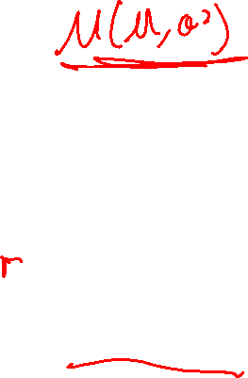
Reparameterization Trick
Sample N(μ, σ²)
Backpropagation does not work for sample operation

Slide 24
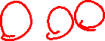
Reparameterization Trick
z = μ + σ×ε
where ε ~ Normal (0,1)

Slide 25
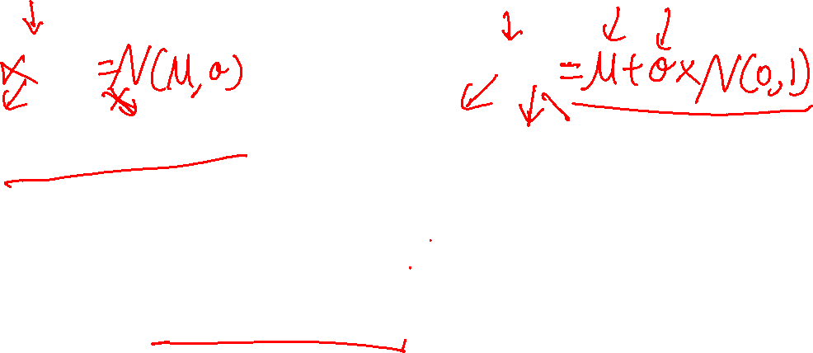
Reparameterization Trick
Original
Reparameterization
f
f
z
z
μ
σ
μ
σ
ε
Deterministic
Random Node

Slide 26
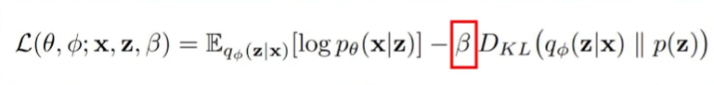
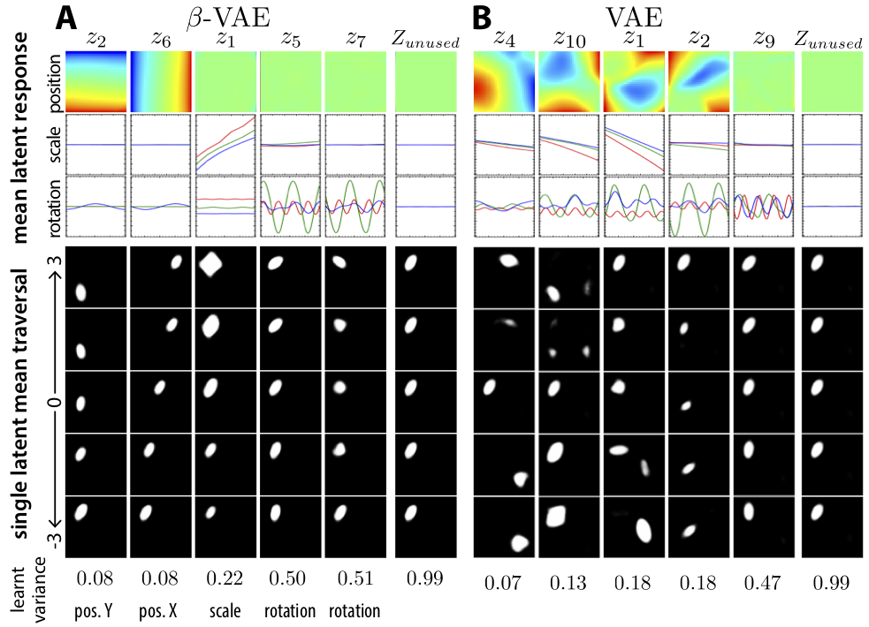
Disentangled Variational Autoencoder
https://openreview.net/forum?id=Sy2fzU9gl

Slide 27
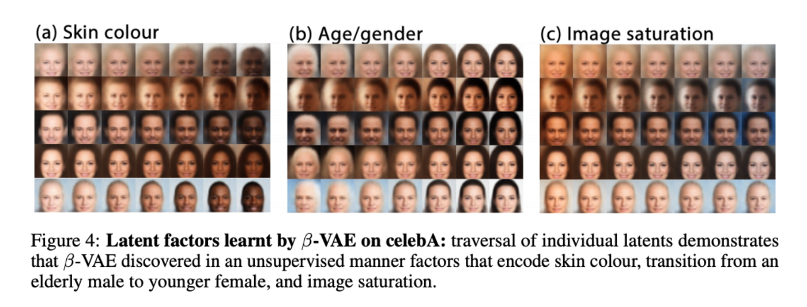
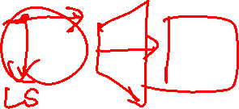
Disentangled Variational Autoencoder
https://openreview.net/forum?id=Sy2fzU9gl

Slide 28
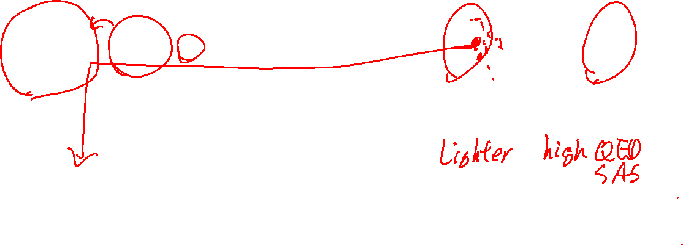
Variational Autoencoder with a Predictor
ACS Cent. Sci. 2018, 4, 268–276

Slide 29
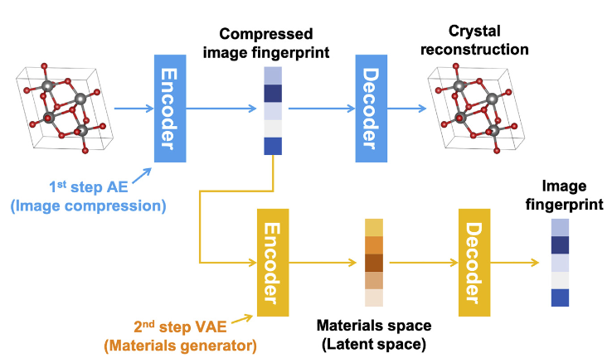
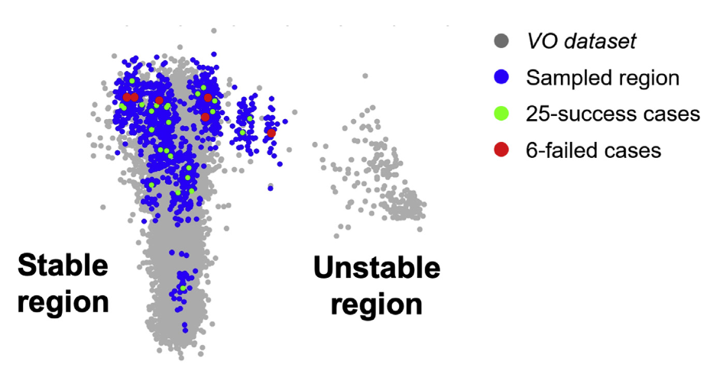
Variational Autoencoder with a Predictor
Matter 2019, 1, 1370-1384

Slide 30
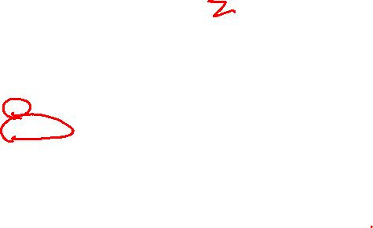
Coding
class Molecule_VAE(nn.Module):
def __init__(self, input_fea, hidden_fea, out_fea):
super(Molecule_VAE, self).__init__()
self.encoder = Encoder(input_fea, hidden_fea)
self.decoder = Decoder(hidden_fea, out_fea)
self.enc_mu = nn.Linear(hidden_fea, hidden_fea)
self.enc_log_var = nn.Linear(hidden_fea, hidden_fea)
def forward(self, x):
"""Forward Function which passes the data through entire model"""
h = self.encoder(x)
z, mu, var = self._sample_latent(h)
recon_x = self.decoder(z)
return recon_x, mu, var, z
def _sample_latent(self, h_enc):
"""
Return the latent normal sample z ~ N(mu, sigma^2)
"""
mu = self.enc_mu(h_enc)
log_var = self.enc_log_var(h_enc)
sig = torch.exp(0.5*log_var)
# Reparameterization trick
std_z = torch.randn(sig.size()).float().to(mu.device)
z = mu + sig * std_z
var = torch.exp(log_var)
return z, mu, var
Reparameterization
f
z
μ
σ
ε

Slide 31
Coding
*Note that this is the loss function we want to maximize so the sign flips
def loss_function(recon_x, x, mu, var):
MSE = torch.mean((recon_x - x)**2)
KLD = 0.5 * torch.mean(-torch.log(var) - 1 + var + mu.pow(2))
return MSE + KLD
$$D_{KL}\left(q_{w}\left(z | x\right)\right|\left|p\left(z\right) \right)=\frac{1}{2}\left[−\log{σ^{2}}−1+σ^{2}+μ^{2}\right]$$

